Slide 1
Business Case 4: forecasting transfer services demand
Alexandra Ordina
Bojan Stavrikj
Henrique Januário
Hugo Mentzingen

Slide 2
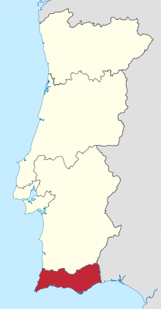
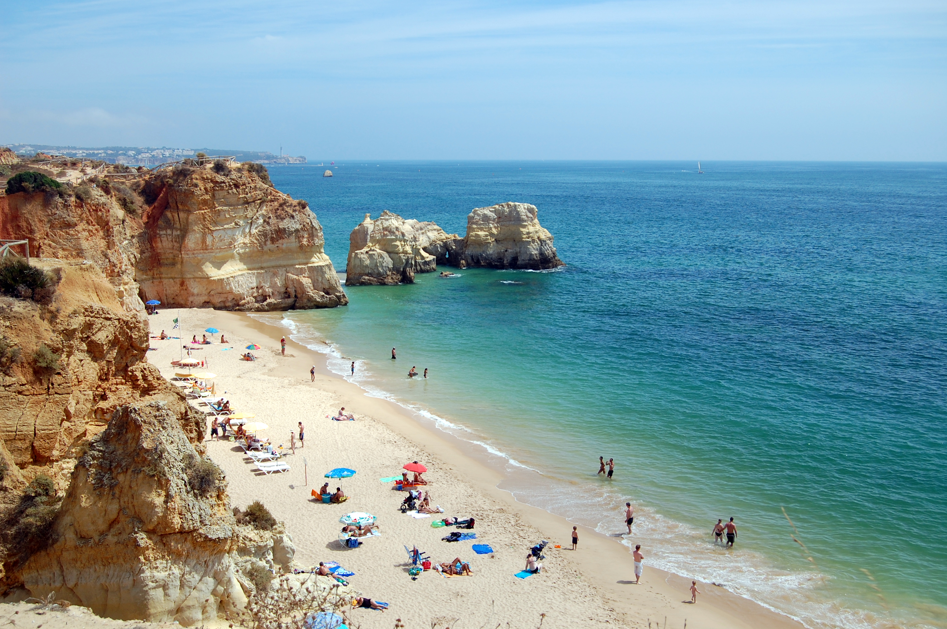

ALGARVE
9 Million
passengers
Best Beach destination 2019

Slide 3


DIFFICULT TO ESTIMATE HOW MANY DRIVERS TO HIRE
OVERESTIMATION HAS COSTS
OUTSOURCING HAS RISKS TO
REPUTATION
UNDERESTIMATION HAS
RISKS TO REPUTATION
DEMAND FLUCTUATES

Slide 4


BUSINESS OBJECTIVES
advance hiring process
Predict 4 weeks batches
Forecast 8 weeks in advance
Maximum deviation 10%

Slide 5



APPROACH AND METHODOLOGY
Predict number of transfers
Train forecasting model
Data Patterns
Test and Select Predictive features
Early bookings
4 years of data

Slide 6

Our analysis

Slide 7
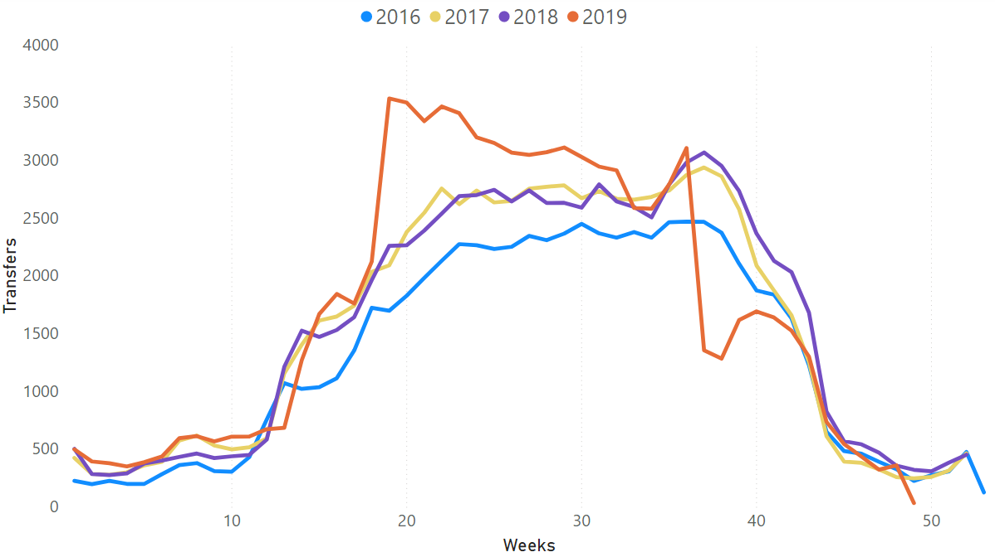
THERE IS A PATTERN
PRE-BREXIT TRAVELLERS
THOMAS COOK CRASH

Slide 8

Value of historic data
AVERAGE LEAD TIME IS 4 WEEKS
HALF OF TRANSFERS ARE BOOKED UNDER 12 DAYS IN ADVANCE
17% TRANSFERS ARE BOOKED 8 WEEKS IN ADVANCE
7% OUT OF THOSE CANCEL LATER
75% TRANSFERS ARE RETURN TRIPS

Slide 9
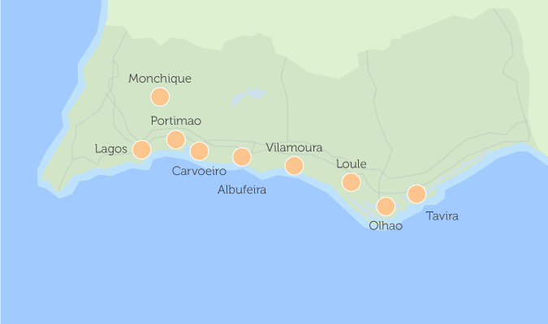
A BIT OF GEO-ANALYSIS
TOP 3 LOCATIONS: FARO, ALBUFEIRA, VILAMOURA
Faro
AVERAGE TRANSFER DISTANCE 33 KM
MAX TRANSFER DISTANCE 554KM
140 SHORT TRANSFERS OF 5-10KM ON AVERAGE PER YEAR

Slide 10




MOST CLIENTS FLY LOW-COST
CLIENT PROFILES
TOP 3 LOCATIONS ARE ALWAYS THE SAME BUT:
LARGER FAMILIES BOOK MORE TRANSFERS TO:
PARK ZOOMARINE
SAGRES
CARRAPATEIRA
LEPE

Slide 11

CLIENT PROFILES
60 FREQUENT TRAVELLERS (>10 TRIPS)
2 OUT OF 100 TRIPS ARE BOOKED BY THEM
80% FREQUENT TRAVELLERS ARE FROM UK
TOP CLIENT
143 TRIPS
3 TRANSFERS PER WEEK
PEAK TIME: WEEKS 23 TO 26

Slide 12

FEATURES THAT MATTER…
NUMBER OF SERVICES BOOKED 8 WEEKS PRIOR
AVERAGE DISTANCE OF THE BOOKED TRIPS
TRANSFER TYPE
NUMBER OF KIDS
PAYMENT TYPE
FREQUENT CUSTOMER RATIO
AVERAGE LEAD TIME

Slide 13

MODEL RESULT
MLP REGRESSOR
DEVIATION FROM REAL TRANFERS NUMBER
UNDER 10%
TESTED ON YEAR 2019
UNDERESTIMATION HAS
RISKS TO REPUTATION

Slide 14

Deployment and Maintenance
IT OR DATA SCIENCE TEAM
TO BE TRAINED FOR
LAUNCH AND FUTURE USE
WEEKLY RUNS: IMPROVES RESULT
AUTOMATIC INPUT TO MODEL FROM WEBSITE (LATER PHASE)
INCORPORATE NEW SPECIAL EVENTS (ONGOING)

Slide 15
FUTURE IMPROVEMENTS
50% OF CLIENTS BOOK MONTH IN ADVANCE:
CONSIDER TO ADOPT DYNAMIC STAFFING (4 WEEKS IN ADVANCE )
GOOGLE MAPS API TO MEASURE REAL DRIVE DISTANCE AND TRIP DURATION
INCORPORATE FLIGHT FORECASTS
WEBSITE: MAKE DROP DOWN FOR FLIGHT NO TO HAVE CLEAN FLIGHT INFO

Slide 16

OTHER IDEAS
“POOLING” CLIENTS
ON SHORTER TRIPS
PARTNER WITH LOW-COST AIRLINES

Slide 17


Thank you! Contact us:
Alexandra
Bojan
Henrique
Hugo

